Slide 1
Auburn Childhood Lead Poisoning and Healthy Housing Data Tracking
Source: Childhood Lead Poisoning | MaineTracking Network (mainepublichealth.gov)
Data retrieved: July 2024

Slide 2
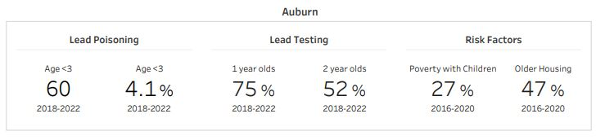
Auburn Lead & Healthy Homes Program
In partnership with the US Housing and Urban Development Agency, the City of Auburn provides support to homeowners and landlords for the purposes of protecting children from the dangers of lead-based paint hazards. This assistance is in the form of assessing hazards, prioritizing needs, and overseeing a coordinated response to lead abatement.

Slide 3
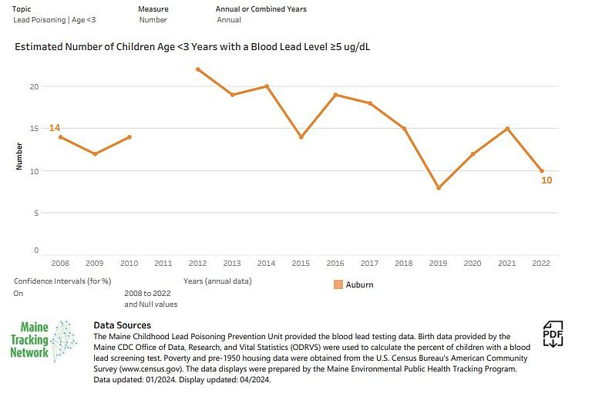
Estimated Number of Children Age <3 Years with Blood Lead Levels greater than or equal to 5 ug/dL

Slide 4
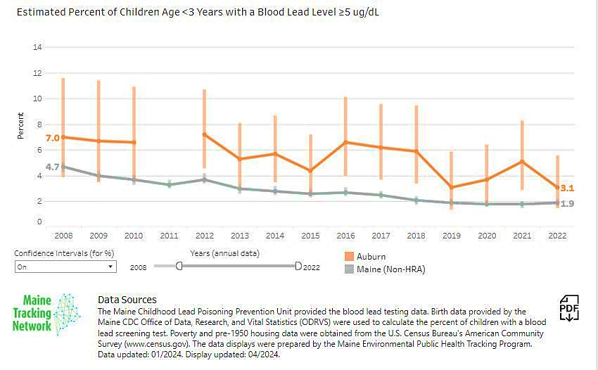
Estimated Percent of Children Aged <3 Years with Blood Lead Levels greater than or equal to 5 ug/dL

Slide 5
Number of Children Age <3 Years with a Blood Lead Test

Slide 6
Percent of Children Age <3 Years with a Blood Lead Test

Slide 7
Number of Housing Units Built Before 1950

Slide 8
Percent of Housing Units Built Before 1950

Slide 9
Number of Families Below Poverty Level

Slide 10
Percent of Families Below Poverty Level

